Slide 1
Principle: Fast Feedback
Get feedback to the people who need it as soon as possible
Work with up to date information and make informed decisions
Automated Regression test suites should run in minutes
Practice: Test Pyramid
Focus on small fast test as compared to large slow tests
Practice: Continuous Integration
The ability of order test execution, so some tests can be run early
Tests should be capable of being run in parallel
Build should be automated and part of continuous delivery practices
Large
Medium
Small
Notes:
Test Pyramid:
Small – tests a single method/function. If it fails you typically know exactly what’s broken. Very fast. Kind of tests that result from TDD.
Medium – tests a small collection of classes. Often used to test acceptance criteria.
Large – end-to-end functional tests. Typically mimic user behaviour. Used to test acceptance criteria. When they pass they give good confidence the system works. Tend to be slow and cause of failure not always clear.
Tradeoffs: Increasing confidence vs. better isolation and speed.
Testing responsibilities:
Small – Developers, often via TDD
Medium – Developers
Large – Developers and QA in partnership

Slide 2
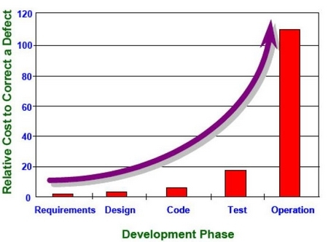
Principle: Build Quality In
Remove the cost of fixing the defects by preventing them from occurring
Find mistakes early and prevent them from becoming prevalent
Reduce reliance on quick fixes
Practice: TDD (Test Driven Development)
Practice: ATDD (Acceptance Test Driven Development)
Practice: Functional Test Automation
Practice: Cross-Functional Monitoring
Practice: Exploratory Testing
Notes:
No reason to opt for Acceptance Test Driven Development (ATDD) or Behavior Driven Development (BDD) unless non-technical people need to author or read test scenarios.
Most of the tools at this level make refactoring tests difficult, which leads to test scenarios being very quickly out of date.

Slide 3
Principle: Everybody is responsible for quality
Testing isn’t just about testers
Get better tests through diverse input and the team looking after tests
Practice: Collaborative Approach
Practice: Perpetual UAT Environment

Slide 4
Principle: Tests are an asset
Treat the test cases and the application code as the product – don’t separate them
Tests must be treated as a first class asset
Reuse tests across projects, don’t create new tests all the time
Better understanding of test coverage – use proper verb
Define legacy code as code that is not under test and refactor when possible
Practice: Version Control
Automated tests are code – treat them like code
Test code is likely to be the largest code base in your organisation
Version controlling application code is common practice – so it should be for test code
Practice: Test Maintenance
Ensure a balanced test portfolio to avoid test runs taking too long and distorted test pyramid (inverted or hourglass)
Encourage pairing between Devs and QAs

Slide 5
Principle: Evolutionary Test Strategy
Shared understanding that testing is an evolving process and improvements are made over time
Practice: Root cause analysis
Identify which particular functional area has problems and work to improve
Practice: Feedback from problems
Use retrospectives/post-mortems to provide feedback related to problems, to improve future state.

Slide 6
Principle: Faster delivery into production
Do not have months of testing after development is complete – build quality inn point
Return on investment early – start earning revenue as soon as you can
Testing should facilitate faster delivery of quality system to production
Practice: Build pipeline (CI & CD)

Slide 7
Principle: Clear and consistent view of testing
Simple reporting so you can compare health of one project with another.
Metrics should not drive behavior.
Open and honest.
Practice: Pragmatic reporting based on need
Practice: Defect prioritization along with user stories
Practice: Clear definition of done

Slide 8
Principle: Optimise business value
Testing is not just insurance
Target testing to features that are changing not a scatter gun test everything approach
Help drive new features and functionality
Allow business to try new ideas in a safe environment providing quick feedback
Allows you to add/change features with confidence while making sure you are not breaking other things
Practice: Risk based testing
Practice: Visibility and understanding of application quality and risks
Practice: Intelligent QA function that has the power to recommend direction

